Slide 1
《英语国家社会与文化入门》（下册）
The Society and Culture
of Major English-Speaking Countries
An Introduction
(Book Two)

Slide 2
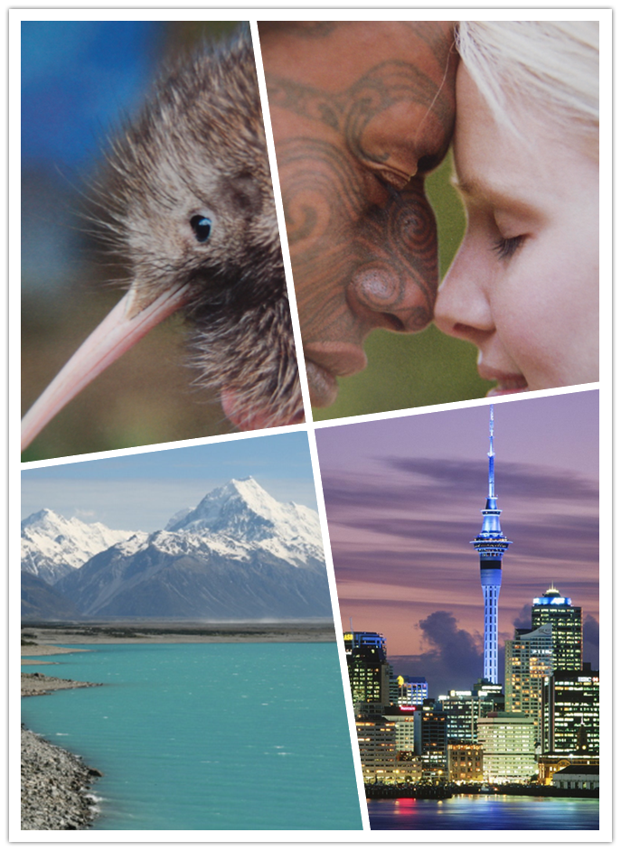
New Zealand
Unit 2 Political System, Education and Economy

Slide 3
Quiz
Give the English and a brief explanation for the following:
1. 混合成员比例代表制
2. 政府特派调查员
3.函授课程
4 . 专属经济区
5. 亚太经合组织

Slide 4
Focal Points of the Unit
Political System
-the Head of State
-Parliament
Mixed Member Proportional Representation
the Cabinet
the Ombudsman
-local government
Education
- primary schools and secondary schools
-the Correspondence School
-universities and polytechnics
Economy
-agriculture
-forests and fisheries
-energy
-overseas trade

Slide 5
The Unit Is Divided into Three Sections:
Political System
Education
III. Economy

Slide 6
I. Political System
the Head of State
Parliament
-Mixed Member Proportional Representation
-the Cabinet
-the Ombudsman
local government

Slide 7
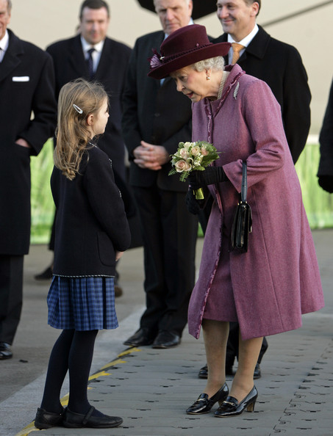
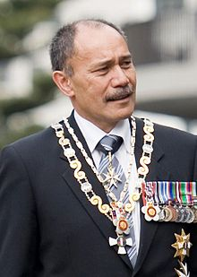
The Head of State
The Head of State of New Zealand is the British monarch Queen Elizabeth II in her capacity as Queen of New Zealand (left: Queen visits New Zealand); she is represented by the Governor-General (right: current Governor-General Jerry Mateparae , the first Maori Governor-General).

Slide 8
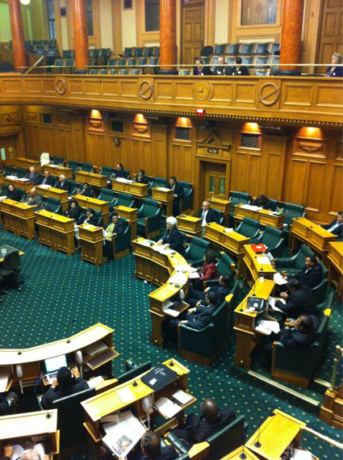
Parliament
-New Zealand is governed by an elected parliament.
-Parliament has a single chamber—the House of Representatives with 122 MPs currently;
-The two main parties in the House of Representatives are the National Party (centre-right) and the Labour Party (centre-left);
-The parliamentary election in 1996 was held for the first time under the proportional representation system known as MMP (Mixed Member Proportional Representation).
The old Parliament chamber

Slide 9
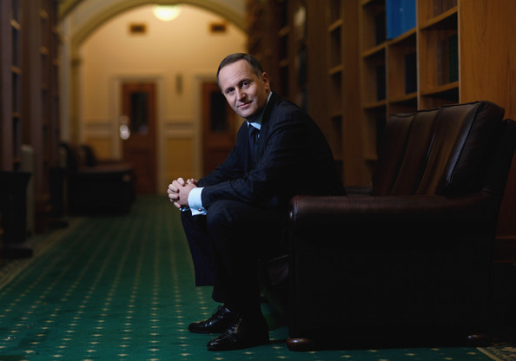
-The Cabinet
New Zealand’s Cabinet is formed by 20 MPs chosen by the Prime Minister as ministers responsible for making government policy, and their responsibilities are called portfolios.
-The Ombudsman
The Ombudsman is appointed by Parliament to investigate people’s complaints against government departments and local authorities, and to ensure that appropriate official information is freely available to the public under the Official Information Act.
John Key (1961- ), the 38th Prime Minister of New Zealand

Slide 10

Three levels of local government:
Local government
- Regional councils with responsibilities for environment overview, resource management, and regional civil defense, etc.;
- Territorial authorities are city, district and county councils with responsibilities for land use consents , libraries, parks and reserves, water, sewerage, rubbish collection, etc.;
- Community boards promoting local community interests and representing the community to its local authority.

Slide 11
II. Education
primary schools and secondary schools
the Correspondence School
universities
polytechnics

Slide 12
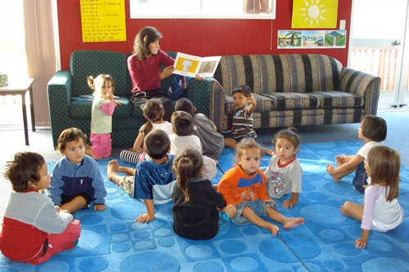
II. Education
Early childhood education
- Crèches take babies from a few weeks old;
- Kindergartens are for two-and-a-half to four-year-olds;
- Kohanga reo (“language nests”) are Māori early childhood education groups encouraging children to use the Māori language. (right: Kohanga Reo)

Slide 13

Primary schools and secondary schools
Free primary and secondary education is a right for all New Zealand citizens and permanent residents from a student's fifth birthday until the end of the calendar year following the student's 19th birthday;
- Education is compulsory between the ages of 6 and 16;
-Children almost always start school on their fifth birthday, or the first School Day after it;
-There are 13 academic year levels, numbered 1 through to 13;

Slide 14
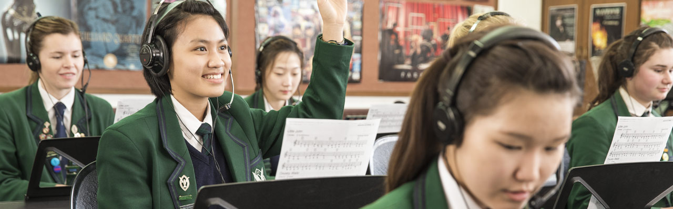
-Students in Years 7 and 8 may attend an Intermediate School which provides a transition from primary schooling to secondary schooling. The last year of primary schooling is Year 8;
-The first year of secondary education is Year 9, and Year 13 is seen as the traditional end of secondary school.
Note: The system of Forms, Standards and Junior, which is described in the textbook, is old and no longer used.

Slide 15
New System Age Old System
Year Level Form, Standard, Junior
1 5 Junior1/Primer 1
2 6 Junior 2/Primer
3 7 Standard 1
4 8 Standard 2
5 9 Standard 3
6 10 Standard 4
7 11 Form 1/Standard 5
8 12 Form 2/Standard 6
9 13 Form 3
10 14 Form 4
11 15 Form 5
12 16 Form 6
13 17 Form 7

Slide 16
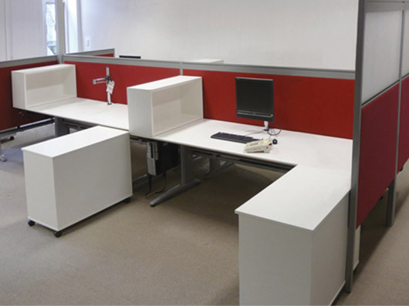
The Correspondence School
-the largest school in the country, providing distance education following the New Zealand curriculum through means of books, radio, TV, web sites and teacher visits for:
-those living in isolated places;
-those unable to attend school because of medical or other reasons;
-those living overseas.

Slide 17
Eight universities in New Zealand:
-University of Auckland
- Auckland University Technology
- Massey University
-University of Otago
-Lincoln University
-University of Canterbury
-University of Waikato
-Victorian University of Wellington

Slide 18
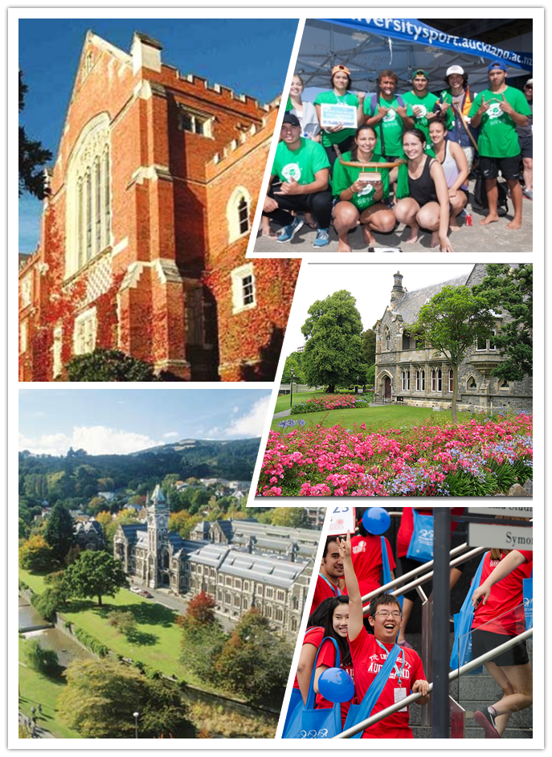
Studying in New Zealand universities

Slide 19

Te Wananga o Aotearoa is a Māori University:
-founded in 1983;
-to provide training and education for Maori, peoples of Aotearoa and the world whose needs are not being met by the mainstream education system;
- committed to the revitalisation of Māori cultural knowledge;
- operating from over 80 locations throughout the country, one of the largest public tertiary education institutions in the nation;
-35,000 students studying at Te Wānanga o Aotearoa in 2010;
-promoted as the largest indigenous peoples college in the world.

Slide 20
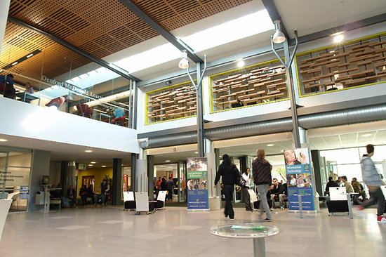
22 polytechnics in New Zealand provide vocational and academic courses covering a large number of subjects at various levels up to degree level:
- The Open Polytechnic is New Zealand's leading distance learning provider; and each year over 34,000 mainly adult students enroll with the Open Polytechnic;
-students learning through print materials, teleconferences, computer-networking, face-to-face seminars, workplace training packages, study groups and block courses, etc.

Slide 21
III. Economy
Agriculture
Forestry
Fishing
Energy
Overseas Trade

Slide 22
III. Economy
Agriculture
-New Zealand’s reputation as the world’s largest farm;
- about 173 million hectares is farmed in a total of about 82 000 farms;
- pastoral farming: 50.2 million sheep and about 8 million cattle;
- cereals such as wheat, barley and oats growing in the South Island; maize in the North;
- major exports including kiwifruit, apples and pears, stone-fruit (peaches, plums apricots etc), onions, squash, flowers and berry-fruit.

Slide 23
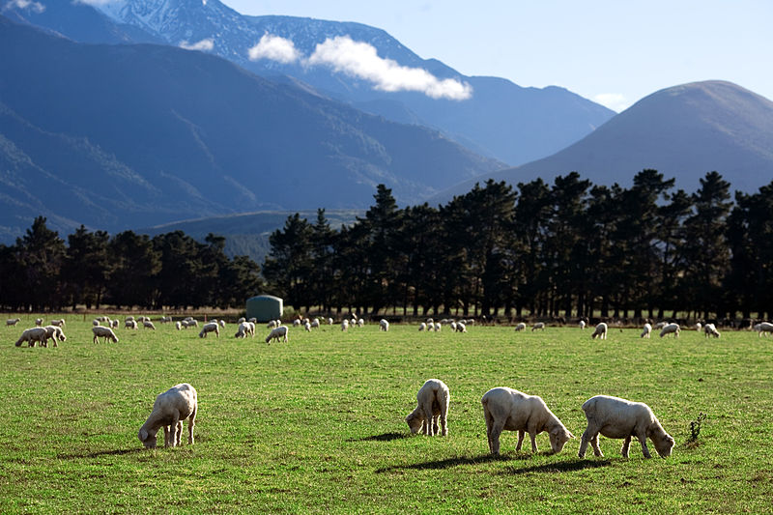
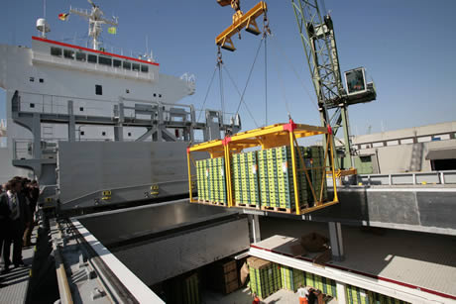
Agriculture
New Zealand rural landscape
Meat and fruit exports

Slide 24
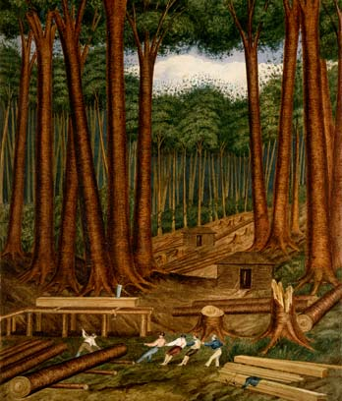
Forestry
-Forestry is a new natural resource-based industry;
- Forests cover more than a quarter of New Zealand, with about 6.2 million hectares are natural forest and 1.3 million hectares are planted production forests;
Forest products are mainly exported to Australia, Japan and Korea;
giant kauri trees were considered by Māori to be the kings of New Zealand’s forest; native forests are being protected and restored. (right: Kauri trees)

Slide 25
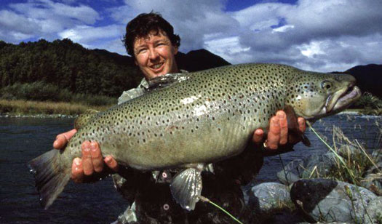
Fishing
- New Zealand's Exclusive Economic Zone is one of the largest fishing areas in the world;
- There are about 100 commercially significant species, from tropical species to cool-water species;
- The most significant markets are Japan, the United States and Australia;
- The seafood industry is the fourth biggest export earner.

Slide 26
Energy
- New Zealand is largely self-sufficient in energy;
- About 60% of the nation’s electricity is provided by rivers;
- About 10% of electricity is from geothermal steam from the volcanic area;
-Other sources of energy include natural gas, wind power, solar power and coal.

Slide 27
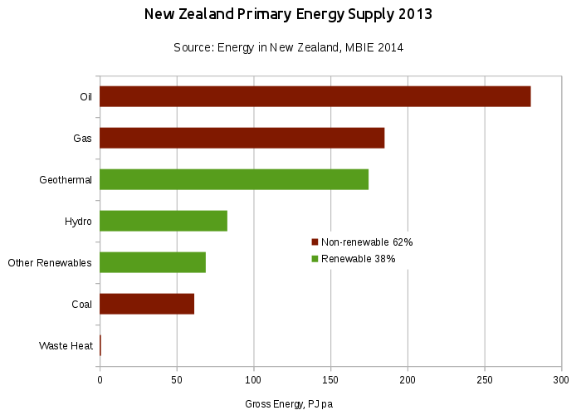

Slide 28
Overseas Trade
- New Zealand lives by trade as the domestic market is limited;
- Farming industries produce more than half of New Zealand’s export earnings;
-Forestry and fishing also play an important role in New Zealand’s exports;
- Manufacturing is growing and now accounts for about 25% of export income;
- New Zealand is a growing international provider of technical and computer services.

Slide 29
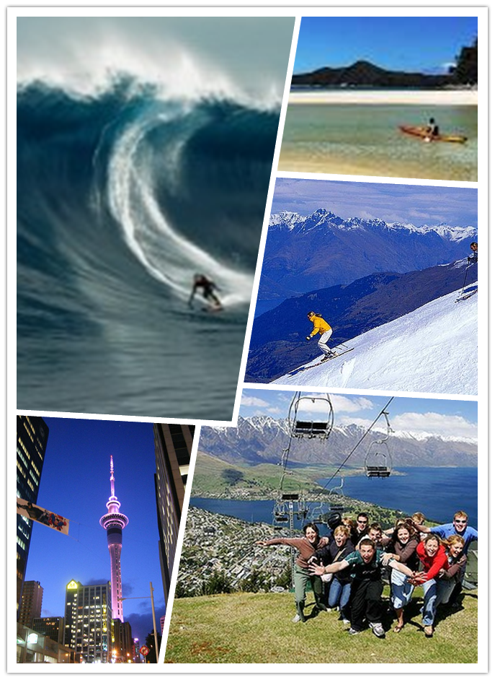
Overseas Trade
-Tourism has been contributing to a substantial increase in earnings, with over 1.5 million international visitors coming to New Zealand every year;

Slide 30
Overseas Trade
-In the past New Zealand had a single market—Britain;
-Now the country has four major markets: Australia, the European Union, Japan, and the United States;
- New Zealand’s trade is becoming more regionally concentrated with about 70% of exports going to Pacific Rim members of the APEC grouping;

Slide 31

Trade between New Zealand and China
New Zealand has a Free Trade agreement with the People’s Republic of China. Singed in April 2008, it is the first free trade agreement that China has signed with any developed country, and New Zealand's largest trade deal since the 1983 Closer Economic Relations agreement with Australia.

Slide 32
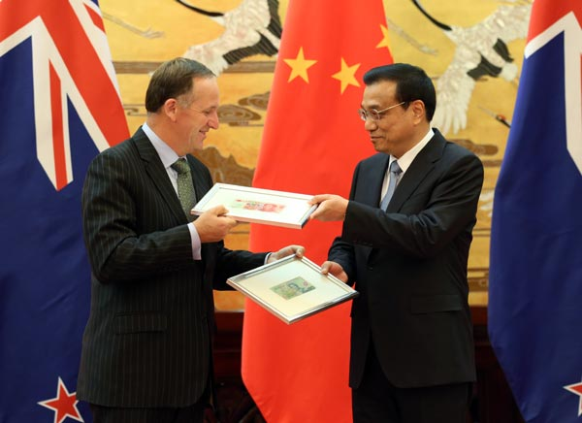
Trade between New Zealand and China
Chinese Premier Li Keqiang and New Zealand Prime Minister John Key exchanged sample banknotes at a ceremony in Beijing on March 18, 2014, announcing that the two countries had approved direct trading between their currencies.

Slide 33
Questions for Discussion
A. What are some of the similarities between New Zealand and Britain in the government system? What are some of the peculiar features of New Zealand’s government system compared with Australia or Britain?
B. Why does the author say that New Zealand’s reputation as the world’s largest farm has been the result of hard work?
C. What do you think of the educational system in New Zealand?
D. What’s New Zealand’s relationship with the rest of the world?

Slide 34
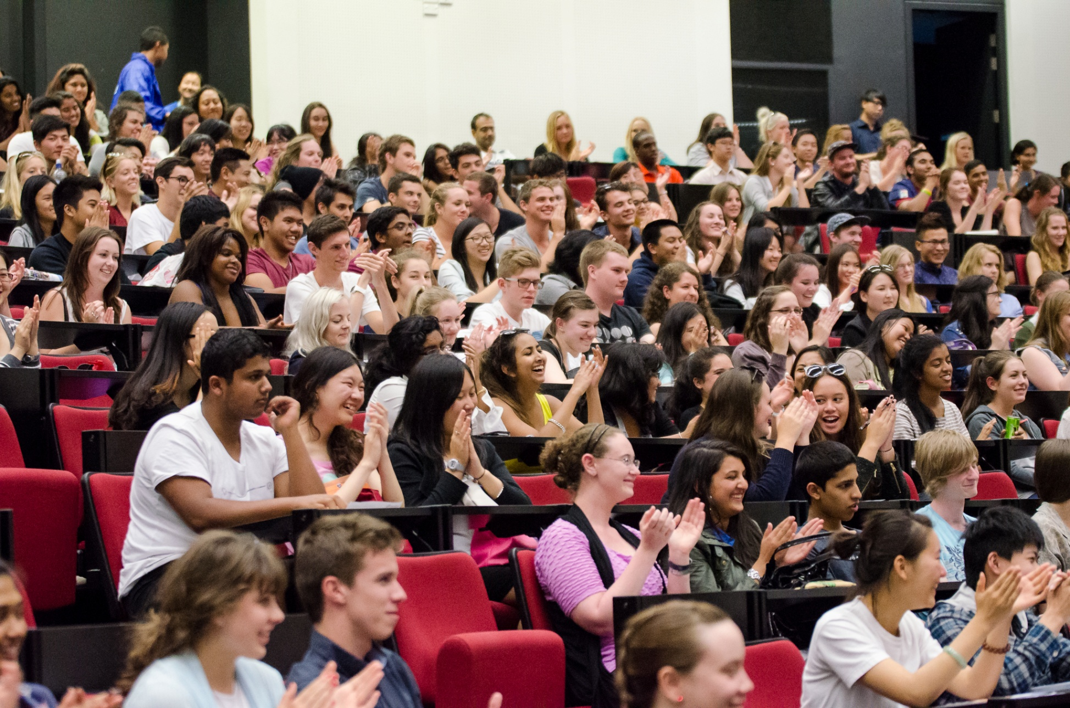

Slide 35
The End
高等教育出版社
2015

